Slide 1
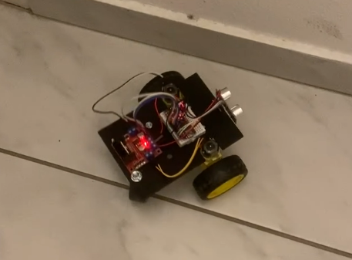



Robot car workshop
by Domokos Kertész

Slide 2
Goal
Understand the basics
Move
Avoid crash
Create custom stuff with the car
Tools for more building

Slide 3
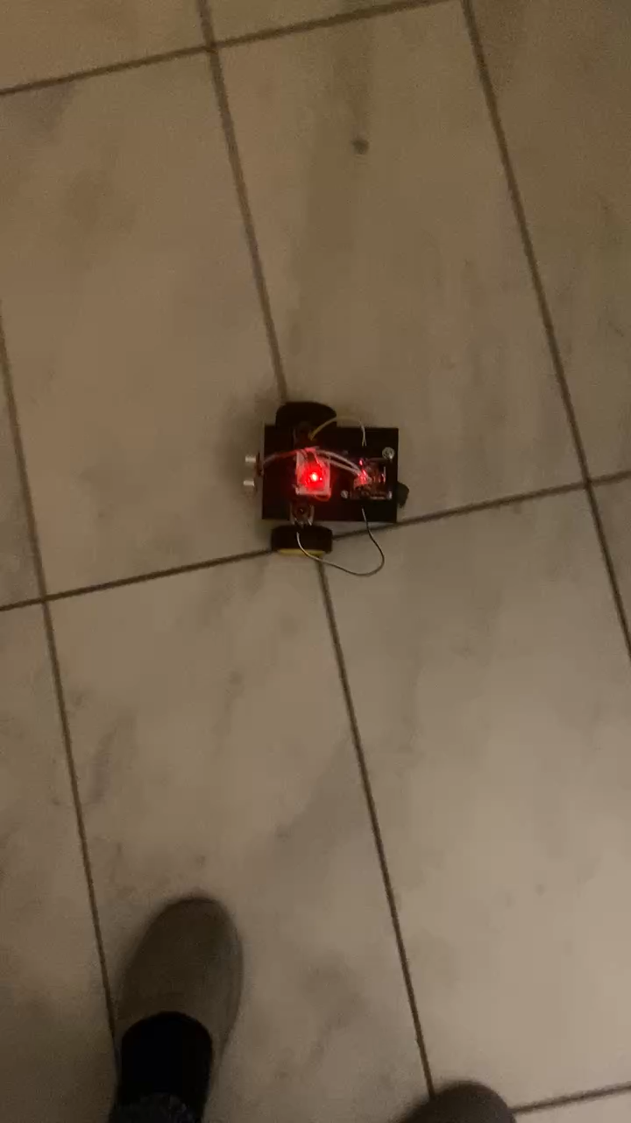

Slide 4
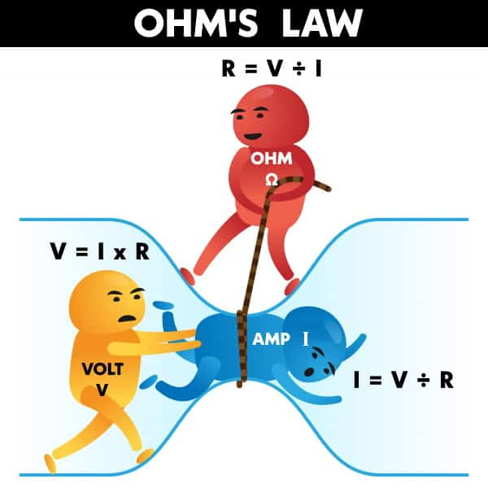
Electricity
A – current (amps) – how many flows
V – voltage (potential difference) – that’s why it flows
R – resistance (ohm Ω) – that’s why it slows
Flow of electrons.
Notes:
Voltage is like a slope

Slide 5
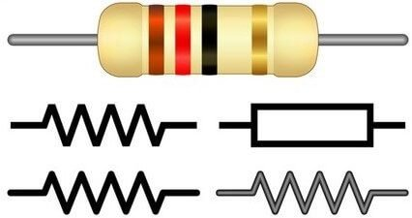
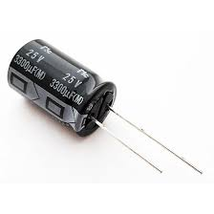
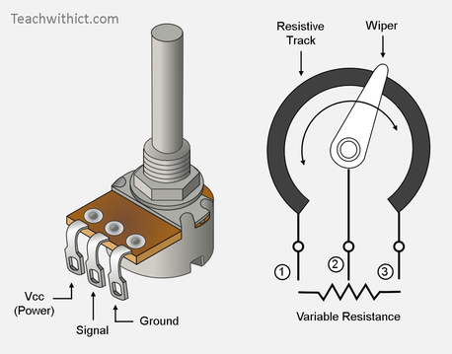
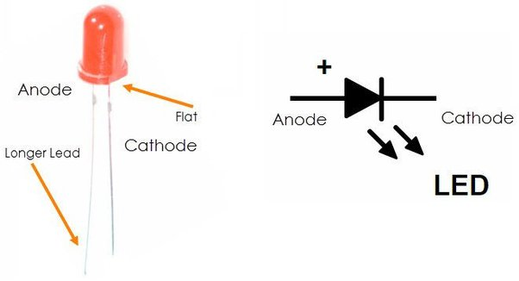
Electrical components
Resistor
Capacitor
LED
Potentiometer

Slide 6
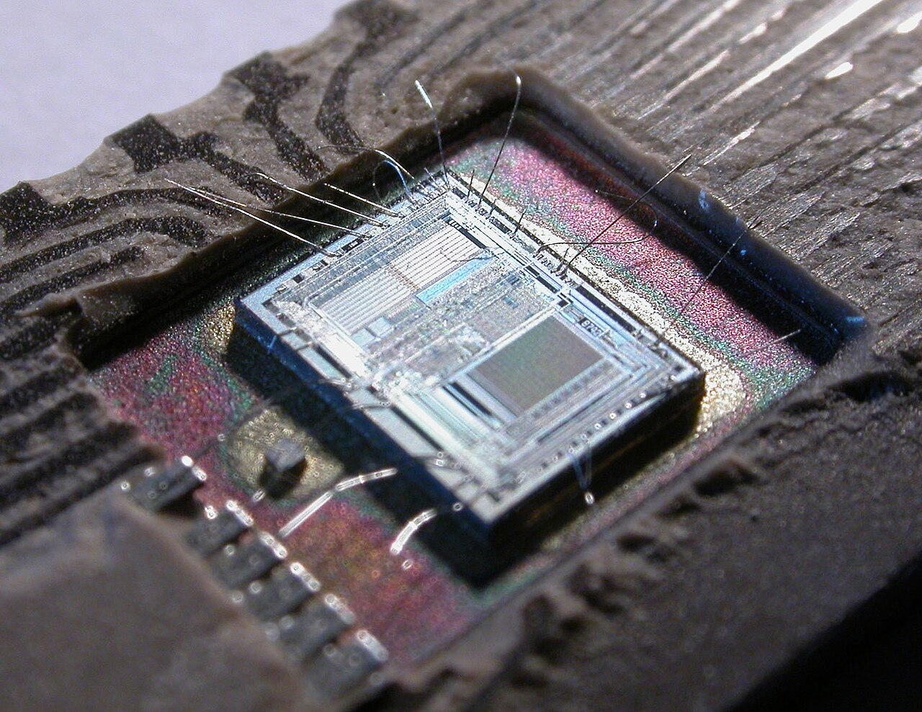
What is a microcontroller
MCU
Processor cores
Memory
I/O
RAM
Embedded applications

Slide 7

What will we use?
Development board
MICROCONTROLLER
USB controller
Pinouts (pin)
CLOCK

Slide 8
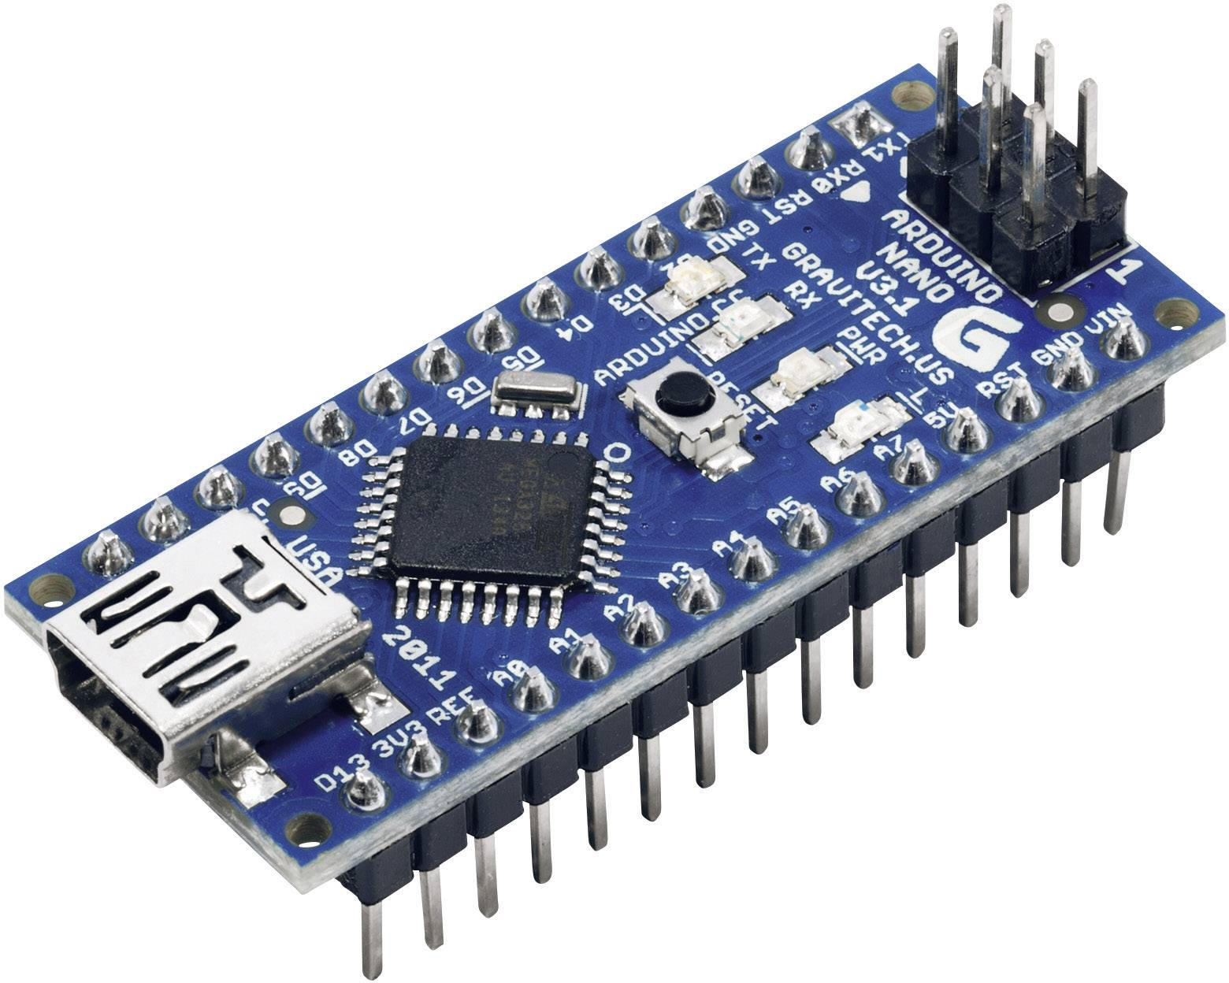
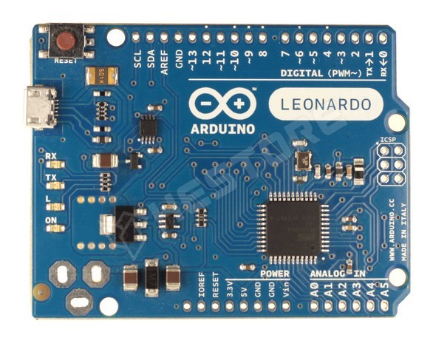
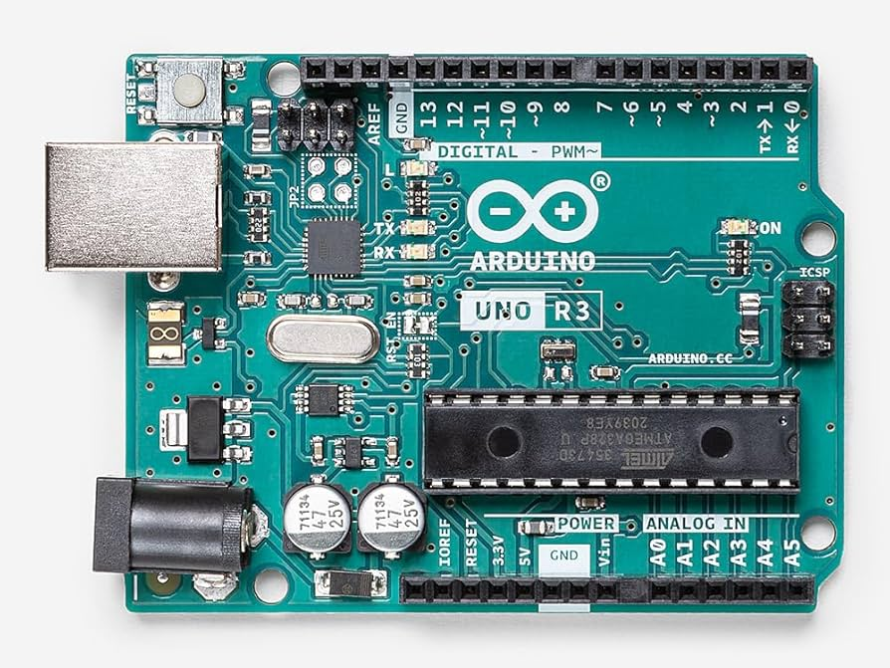
Arduino
Open-source hardware company
Qualcomm exit
ATMEL based boards
UNO
Leonardo
Nano

Slide 9
Arduino nano
ATmega328/ATmega168
Program memory size: 16kB
Data RAM: 1kB
Clock frequency: 20MHz
ROM size: 512B
Chinese clone

Slide 10
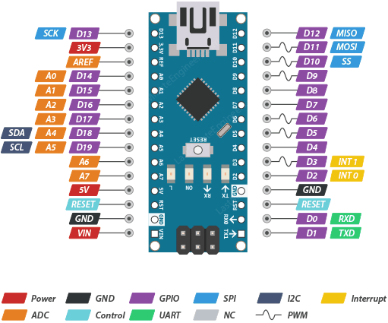
Arduino nano
Analog IN
PWM
Pinouts

Slide 11
Interface – Arduino IDE
Interface for programming
Lightweight IDE
Build system
Upload system
Different hardware different architecture
arm-gcc, avr-gcc
#include <Arduino.h>

Slide 12
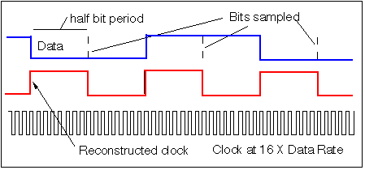
Async communication protocols

Slide 13
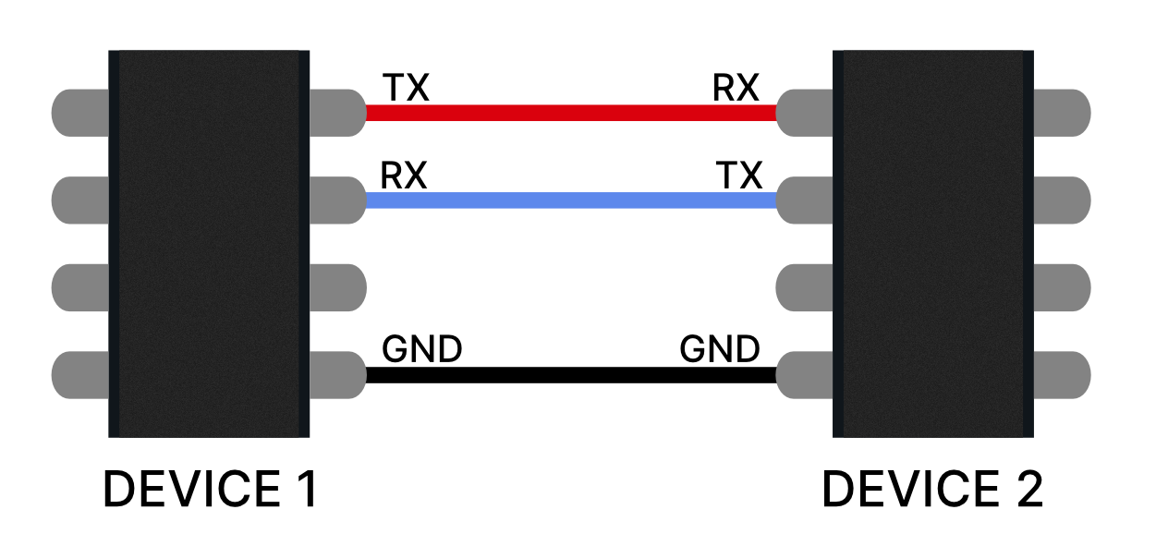
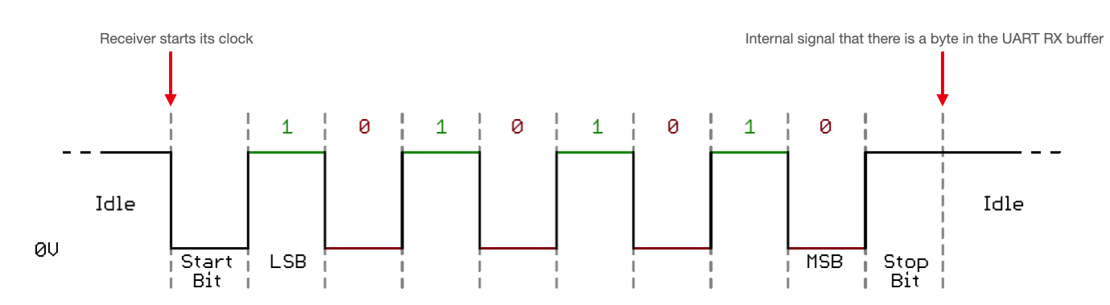
Interface – serial communication

Slide 14
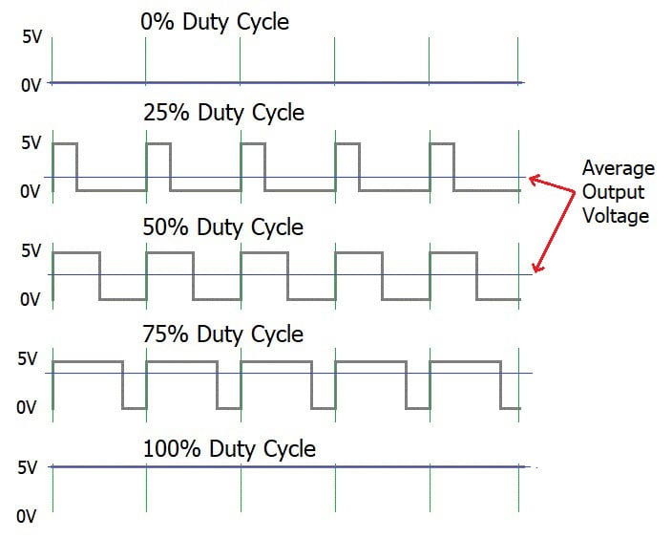
PWM – pulse width modulation
We can’t do analog
Let’s fake it!
(motors can’t take it)

Slide 15
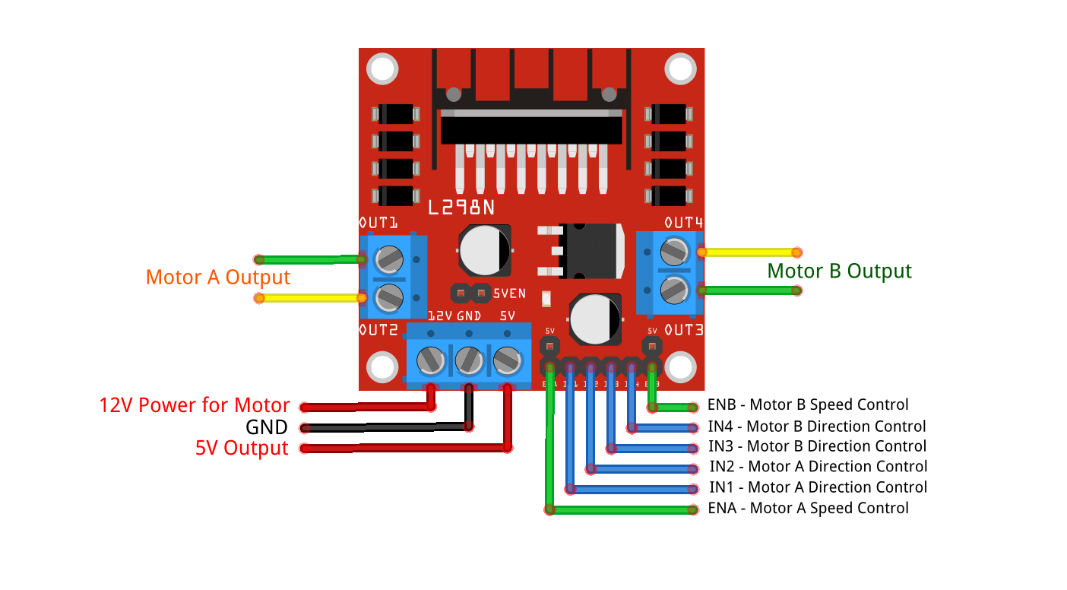
Motor controller

Slide 16
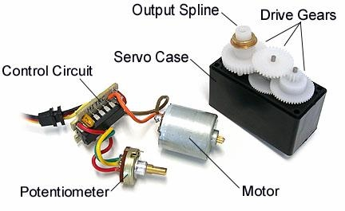
Microservo motor
Angle
PWM

Slide 17
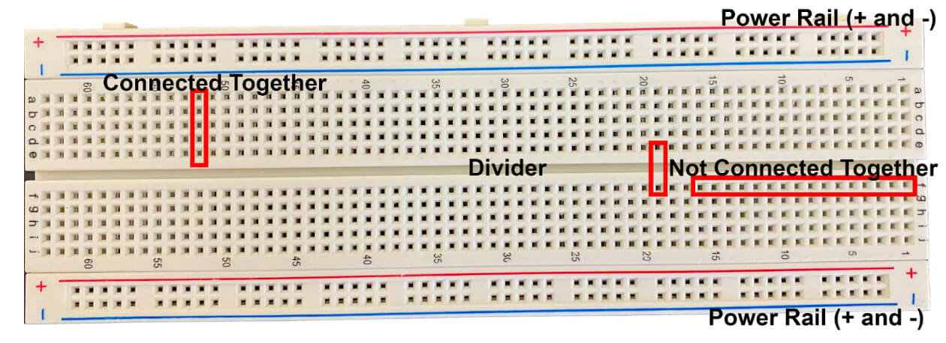
Breadboard

Slide 18
Programming basics
Variable (has a type and a value)
Function (has input(s) and output(s))
Syntax
close everything [{(
; after every line
Space doesn’t matter (if it’s not inside a word)
Neither enter

Slide 19
Arduino functions
void setup() – once on every start
void loop() – runs constantly
delay([waiting in ms]) – waits till the parameter
pinMode(pin, OUTPUT/INPUT) – sets a pin in/output
digitalWrite(pin, 1/0) – turns in or out a pin
analogWrite(pin,0-255) – writes a PWM signal

Slide 20
PWM – pulse width modulation
We can’t do analog
Let’s fake it!
(motors can’t take it)

Slide 21
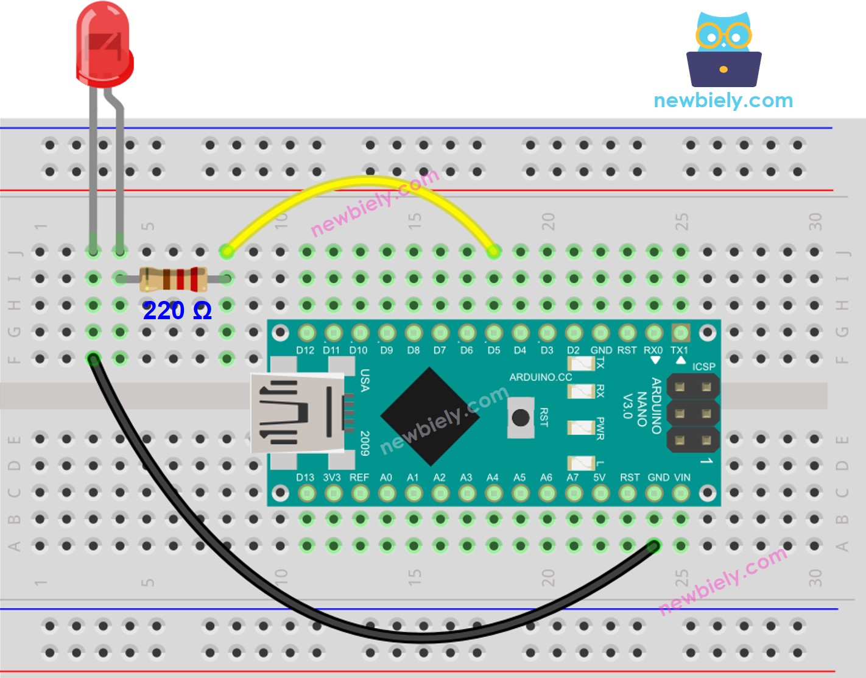
First code – blink a LED

Slide 22

Make the wiring!
Do not connect – and +
GND and 5v
GND and 3v3
GND and VIN
OR

Slide 23
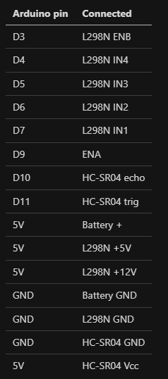
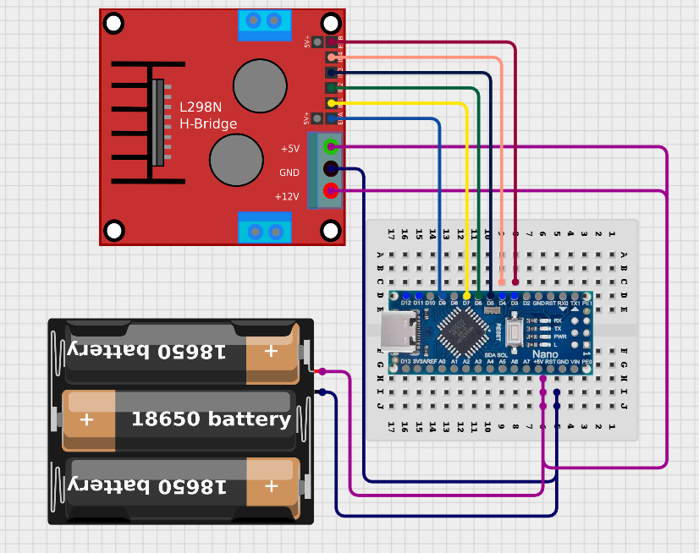
Wire up!

Slide 24
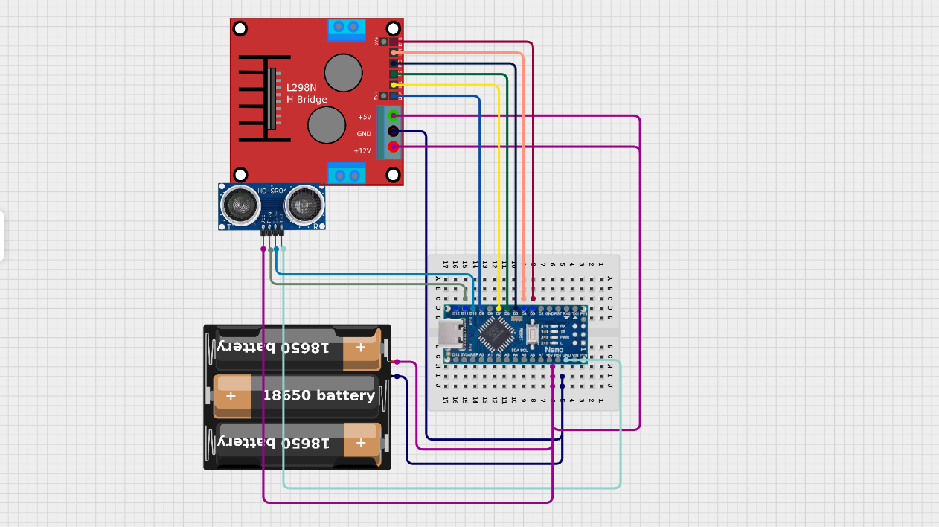

Slide 25
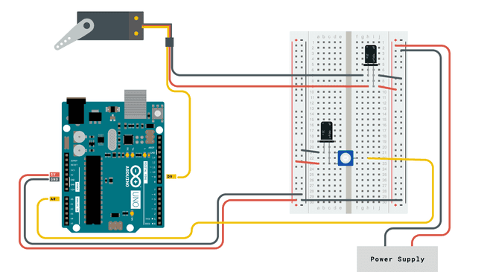
Servo functions
Connect to a PWM pin (and + & -)
# include <Servo.h>
Servo myServo(pinNumber)
myServo.write(angle)

Slide 26
If we have time… Overviews

Slide 27
CAD design
Onshape -> web-based CAD software
https://cad.onshape.com/signin

Slide 28
Electrical design
KiCad
PCB and circuit design
Schematic
Board
PCB order from JLCPCB
Notes:
Kicad Demo

Slide 29
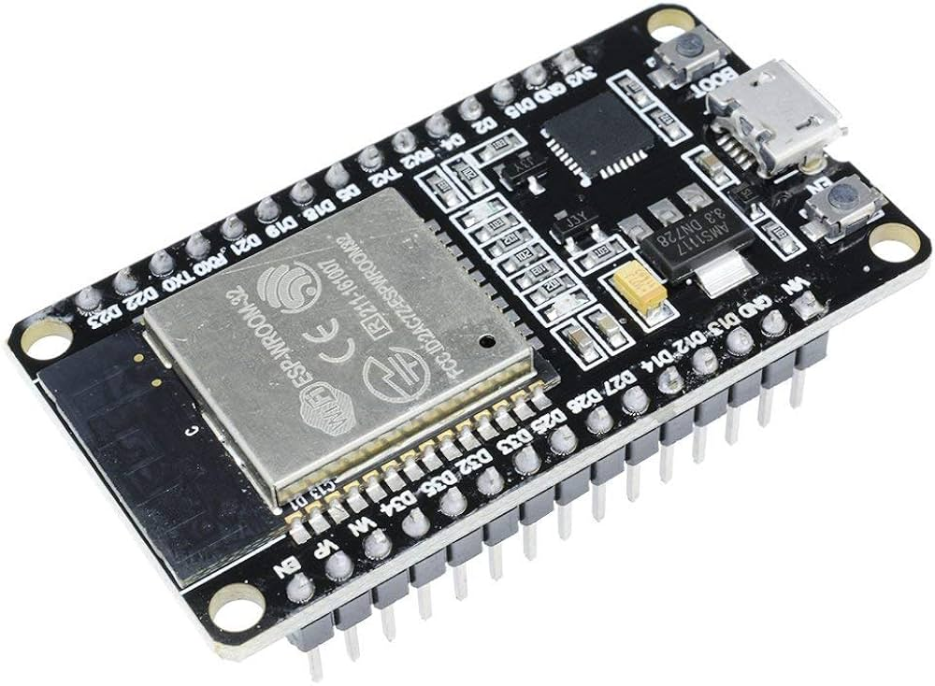
Good to know – ESP
WiFi capable microcontroller
Bluetooth or WiFi
Dev boards

Slide 30
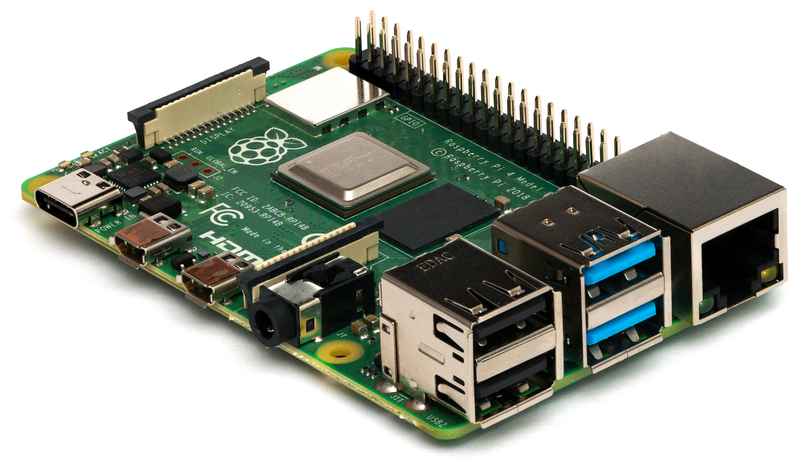
Good to know – Raspberry pi
COMPUTER, not microcontroller
Linux system
GPIO pins
Complex logic – written in any language

Slide 31
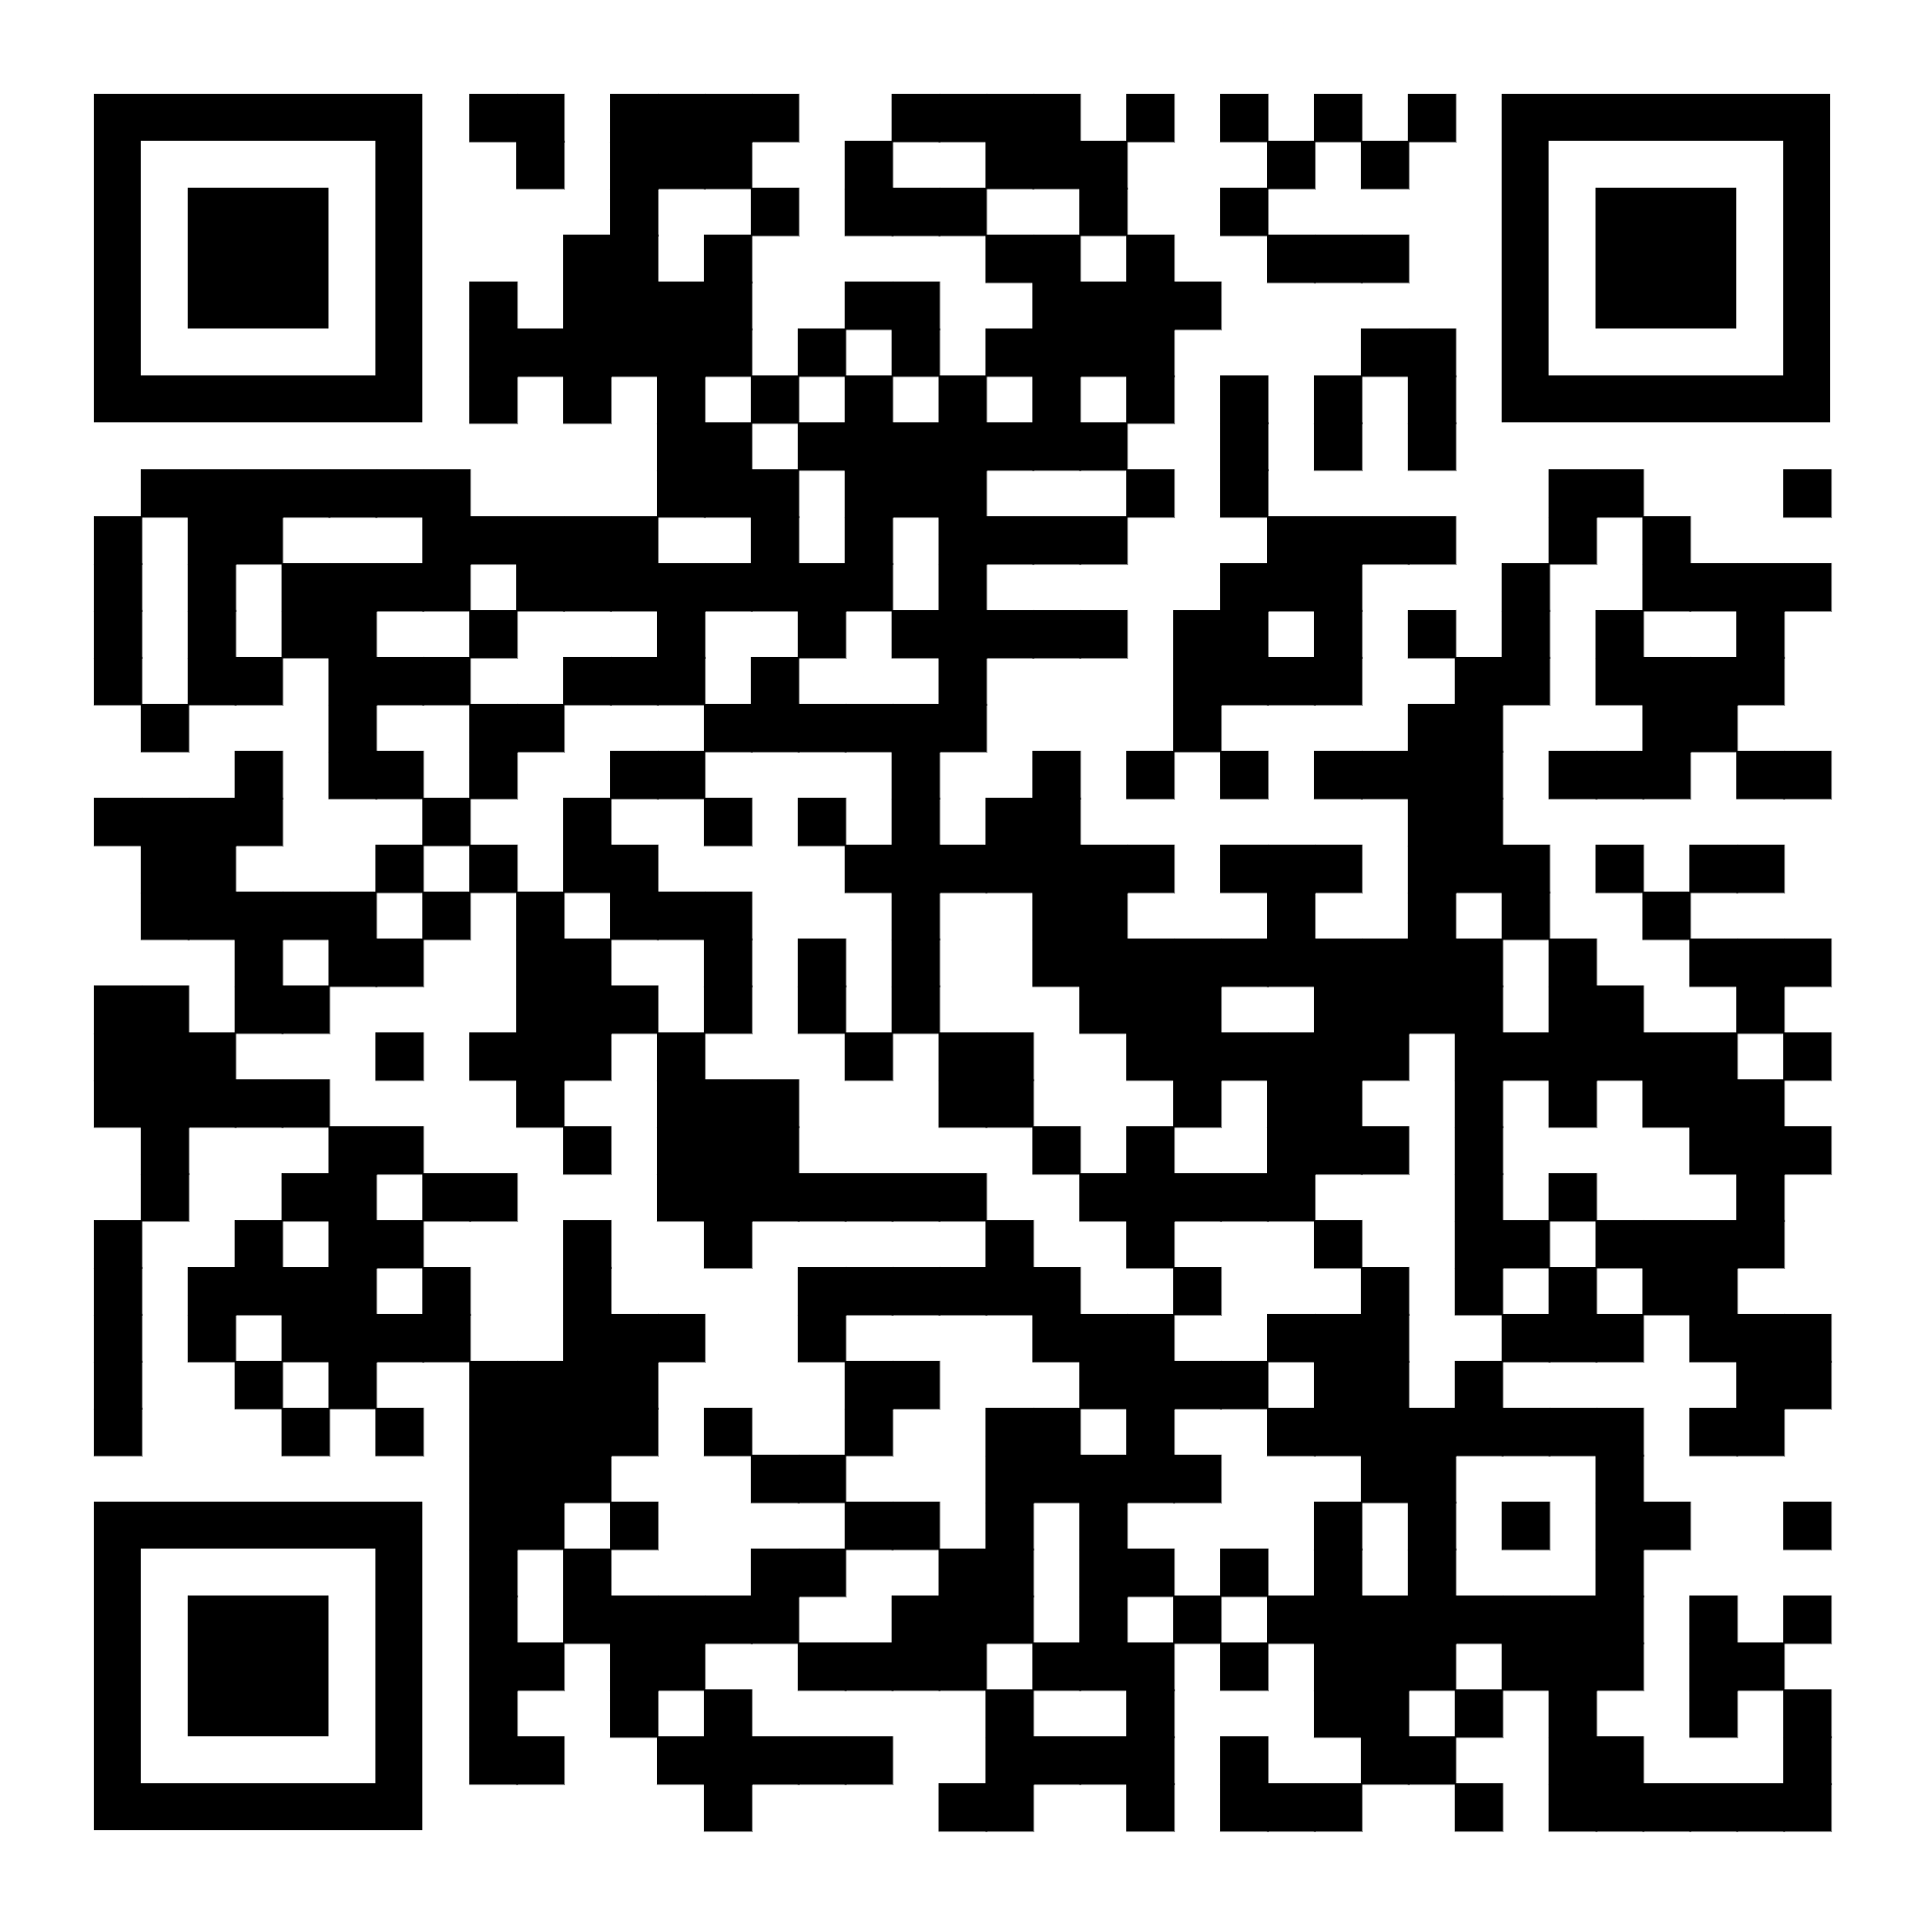
How to build at home?
Github repo
BOM – buy
3D model – print (or make it from wood)
Code!
Buy other stuff and experiment!
https://github.com/KerteszDomokos/robotcar-workshop

Slide 32
Thanks! Ask me! kerteszdomokos@gmail.com

